Slide 1
SOF 103
C and C++ Programming
Objects & Classes

Slide 2
Vision and Mission
Vision
Xiamen University Malaysia aspires to become a university with a distinct global outlook, featuring first-class teaching and research, and embracing cultural diversity.
Mission
To nurture young talents with dignity and wisdom, turning them into fine citizens of the region who will contribute to the prosperity of the people and social progress of Malaysia, China and Southeast Asia.
Compile by Dr. Hew

Slide 3
OOP
So far we have practiced on procedure programming.
From now on, we will explore another programming philosophy, Object Oriented Programming.
- It is based on procedural programming, but different in the perspective of thinking.
We use classes to define data types. When we create variables with classes, these variables called objects.
Using classes properly can enhance modularity and make large-scale system design and development easier.
https://www.youtube.com/watch?v=CqlM7JjnAi4

Slide 4
OOP vs PP
OO Program | Procedural P
Design around the data and objects More secure | Design around actions and logic. Less secure

Slide 5
Procedure Approach is recommended
When..
Speed of execution is very critical
Memory constraints are very high
Code is small
Changes are not frequent.

Slide 6
Some Object-Oriented Terminologies
Object Inheritance
Instance Class
Behavior Methods
State Variables
Encapsulation Message
Abstraction Constructor
Polymorphism Virutal Function

Slide 7
State and Behavior
All real-world objects have state and behavior
In virtual world, an object maintains its state in properties/variables and its behavior in methods/functions.

Slide 8
Two characteristics of real world objects
State | Behaviour
name | eat
age | drink
height | walk
weight | sleep

Slide 9
Class & Object in real world
Class | Objects
Car | SUV, Sedan, MPV
Family | Father, Mother, Sister, Brother

Slide 10
Class & Object in C++ (1)
class Family{
string name;
int age;
float weight, height;
public:
void getData();
void displayData();
};
void Family::getData(){
cout<<"\nEnter family member name, age, weight, height: ";
cin>>name>> age>>weight>>height;
}
void Family::displayData(){
cout<<"\nFamily member name: "<<name;
cout<<"\nFamily member age: "<<age;
cout<<"\nFamily member weight: "<<weight;
cout<<"\nFamily member height: "<<height;
}

Slide 11
Class & Object in C++ (2)
int main()
{
Family member1, member2;
member1.getData();
member2.getData();
member1.displayData();
member2.displayData();
return 0;
}

Slide 12
Objects and Instances
An object is a self-contained element of a computer program that represents a related group of features and is designed to accomplish specific tasks
Objects are also called instances.

Slide 13
Classes
A class is the blueprint / template that defines the variables and methods common to all objects of certain kind, from which multiple objects with similar features are created.
A class is a datatype whose variables are objects

Slide 14
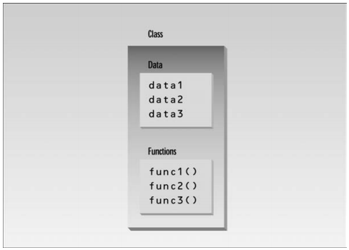
Classes Contain Data and Functions

Slide 15
Class Variables and Methods
A class variable is an item of information that defines an attribute/state of an entire class.
Class methods implement behavior for the entire class.

Slide 16
Benefits of Classes
Reusability – programmers can use the same class and therefore the same code over and over again to create different objects

Slide 17
Car Class Hierarchy
Car
SUV
Mini Van
Sports Car

Slide 18
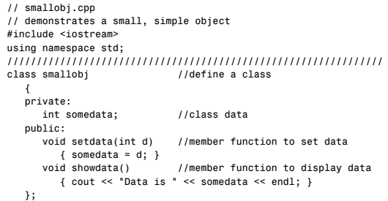
A Program to Demonstrate Class and Objects

Slide 19
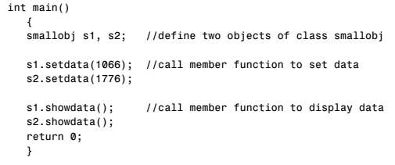
Cont…

Slide 20
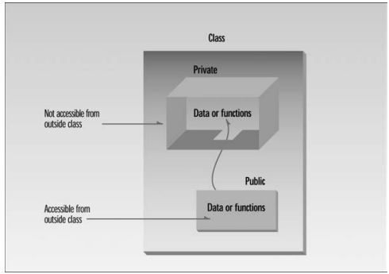
Private and Public Keywords

Slide 21
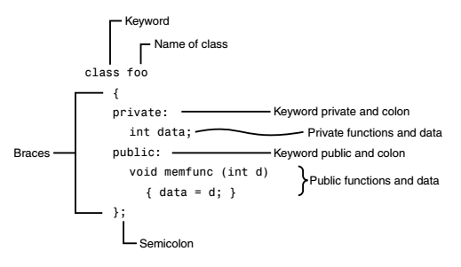
Summing-up Class Definition

Slide 22
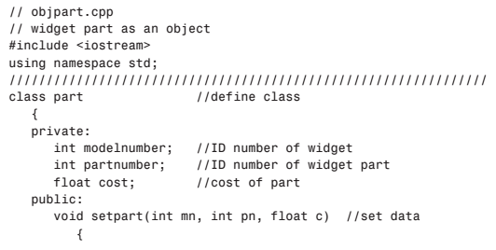
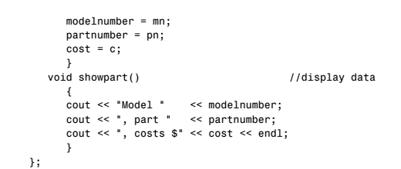
Widget Part as an Object

Slide 23
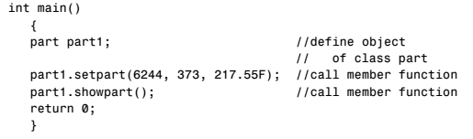
Cont…

Slide 24
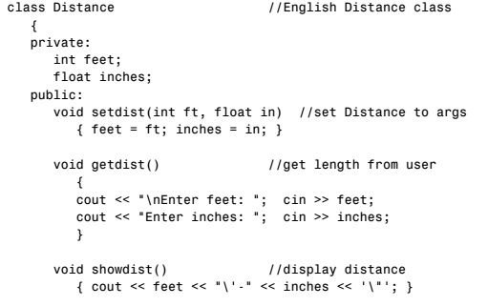
Program: objects using English measurements

Slide 25
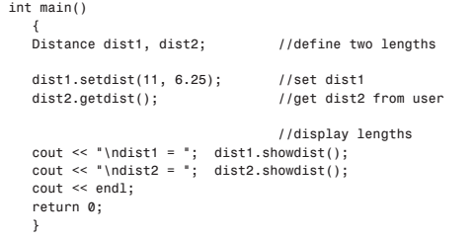
Cont…

Slide 26
Constructors
Every program must have a constructor. A constructor is a special member function whose task is to initialise objects of its class.
A constructor is a member function that is automatically called when an object of that class
is created.
If we didn’t declare any constructor in class, the compiler will add a default constructor which has empty body { } //Doesn’t do anything

Slide 27
Constructor: cont…
You can define a constructor the same way that you define any other member function, except for two points:
1. A constructor must have the same name as the class.
2. A constructor definition cannot return a value.
3. A constructor do not have any return type, not even void.

Slide 28
A Constructor Example Program 1
#include<iostream>
using namespace std;
class Test{
public:
Test(){
cout<<"This is message from the Constructor!";
}
};
int main()
{
Test t1;
return 0;
}

Slide 29
A Constructor Example Program 2
#include<iostream>
using namespace std;
class Test{
int x,y;
public:
Test(){
x=1, y=2;
}
void show(){
cout<<" x is "<<x<<", y is "<<y;
};
int main()
{
Test t1;
t1.show();
return 0;
}

Slide 30
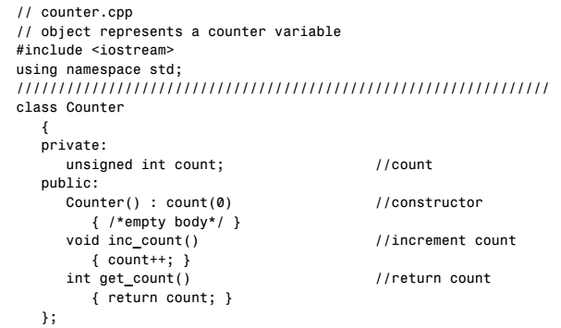
Counter.cpp

Slide 31
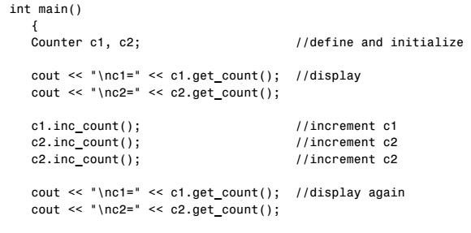


Slide 32
Constructor Overloading
Mean making multiple constructor in same class. These constructor can be distinguished by looking at their parameter.
For example: Complex(); Complex(float a) ; Complex(float a, float b);
Since there are now three explicit constructors with the same name, Complex(), we say the constructor is overloaded.
The call to constructor depends on the number of arguments used in the definition:
  Complex(); // calls first constructor
  Complex(8.8); // calls second constructor
  Complex(11, 6.0); // calls third constructor

Slide 33
Constructor Overloading Example
class Complex{
float x,y;
public:
Complex(){
x=0, y=0;
}
//Here we are doing constructor overloading. We may initialise x=0, y=a too.
Complex(float a){
x=a, y=0;
}
Complex(float m, float n){
x=m, y=n;
}
void show(){
cout<<"X="<<x<<" Y="<<y<<endl;
}
};

Slide 34
Cont…
int main()
{
Complex obj1(1.23), obj2, obj3(3.14,2.8);
obj1.show();
obj2.show();
obj3.show();
return 0;
}

Slide 35
Copy Constructor
Copy constructor is used to declare and initialise an object from another object.
For example: We defined a class called Complex. Then we create an object as following:
Complex obj1(10);
Complex obj2(obj1) //Copy constructor. value in obj1 is copied to obj2. The compiler automatically makes copy constructor. However we should writes it manually.
Other forms of Copy Constructor:
i) Complex obj2; obj2=obj1;
ii) Complex obj2=obj1;

Slide 36
Copy Constructor Example
(Compiler make copy constructor automatically)
class Complex{
float x;
public:
Complex(){
}
Complex(float a){
x=a;
}
void show(){
cout<<"X="<<x<<endl;
}
};
int main()
{
Complex obj1(1.23);
Complex obj2=obj1;
obj1.show();
obj2.show();
return 0;
}

Slide 37
Copy Constructor Example
(User make copy constructor manually)
class Complex{
float x;
public:
Complex(){
}
Complex(float a){
x=a;
}
void show(){
cout<<"X="<<x<<endl;
}
Complex(Complex &temp) { x=temp.x; cout<<"Munual Copy Constructor\n";}
};
int main()
{
Complex obj1(1.23);
Complex obj2=obj1;
obj1.show();
obj2.show();
return 0;
}

Slide 38
Destructors
A destructor is used to destroy objects that have been created by constructor.
A function which is called automatically when an object is destroyed.
A destructor has the same name as the constructor but is preceded by (~ )
For example: If the constructor name is Test(), then the destructor is ~ Test().

Slide 39
Characteristic of Destructor
Do not have a return value.
They also take no arguments.
Only one destructor is needed to destroy all objects created by constructor.
Compiler automatically makes destructor.

Slide 40
Characteristic of Destructor
class Test{
public:
Test(){
cout<<" Constructor\n";
}
~Test(){
cout<<" Destructor\n";
}
};
int main()
{
Test obj1;
return 0;
}

Slide 41
Member Functions Defined Outside the Class
Till now, we have declared the methods like this:
  void add_dist( Distance, Distance ); //defined inside class def
In order to define it outside class definition, following syntax can be used:
void Distance :: add_dist(Distance d2, Distance d3)
{
}
Scope Resolution Operator

Slide 42
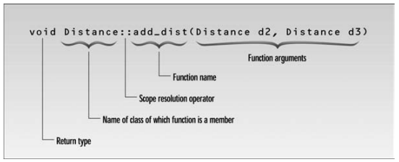
Cont…
Defining a function/method outside class definition

Slide 43
Why use OOP?
Objects have the property of information hiding.
This means that although objects may know how to communicate with one another across well-defined interfaces, objects normally are not allowed to know how other objects are implemented.
Implementation details are hidden within the objects themselves.

Slide 44
Why use OOP? (Continued)
OOP allows software reusability. A class once written can be used by multiple clients across different software projects. (Write once, use multiple times)
OOP allows scalability. OOP is applicable to small software projects up to software projects involving hundred thousands lines of codes. It is easier to maintain and debug code written in object-oriented design in large scale software projects.

Slide 45
References
  Problem Solving with C++ (10th Edition), Walter Savitch, Addison Wesley, 2018
  Paul J. Dietel, C++ How to Program (10th Edition), Pearson, 2017.
  Turbo C programming for the PC, Robert Lafore
  Dr. Kamran’s notes.
SOF103 by Dr. Kamran Siddique

